Slide 1

Team Hackermen
Project: ticket salad

Slide 2
Table of Contents
Introduction
Description of the Project
Domain model of the Project
The outline of Requirements and design document
Package diagram
Deployment diagram

Slide 3
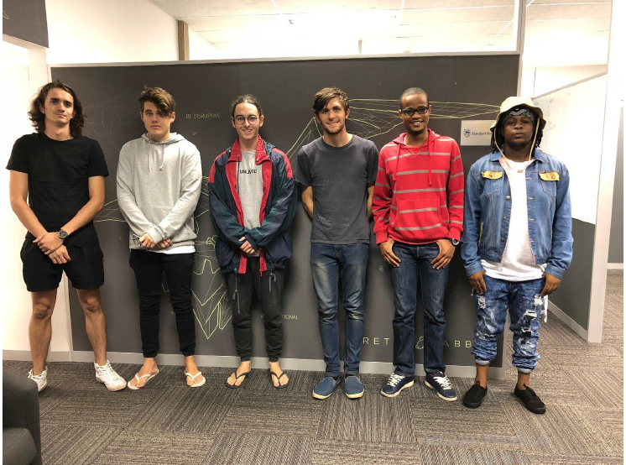
Introduction
Team member’s Names from left to right:
Brandon Teixeira
Jarryd Baillie
Tristan Joseph
Thomas Honiball
Keorapetse Shiko
Thato Gift Mothusi

Slide 4
A Brief Description of the Project
Ticket Salad is a mobile application that is competition based ,it also serves as an online store for events and holiday packages
The competition platform incorporated into the application allows users to get high-end tickets at extremely low rates.

Slide 5
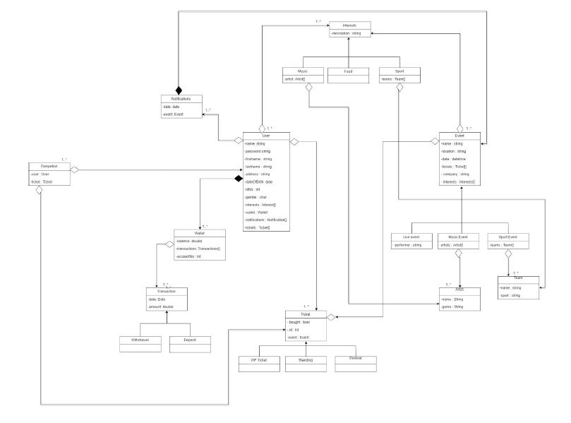
Domain Model of The Project

Slide 6
Outline of Requirements and Design Document
Introduction
1.1 Purpose
1.2 Scope
1.3 Overview
Overall Description
2.1 Product Perspective
2.1.1 System Interfaces
2.1.2 User Interfaces
2.1.3 Hardware Interfaces
2.1.4 Software Interfaces

Slide 7
2.2 Product Functions
2.3 User Characteristics
2.4 Constraints
2.5 Assumptions and Dependencies
3. Specific Requirements
3.1 External Interface Requirements
3.2 Functional Requirements
3.3 Performance Requirements
3.4 Design Constraints
3.5 Software System Attributes
4. Non-functional Requirements

Slide 8
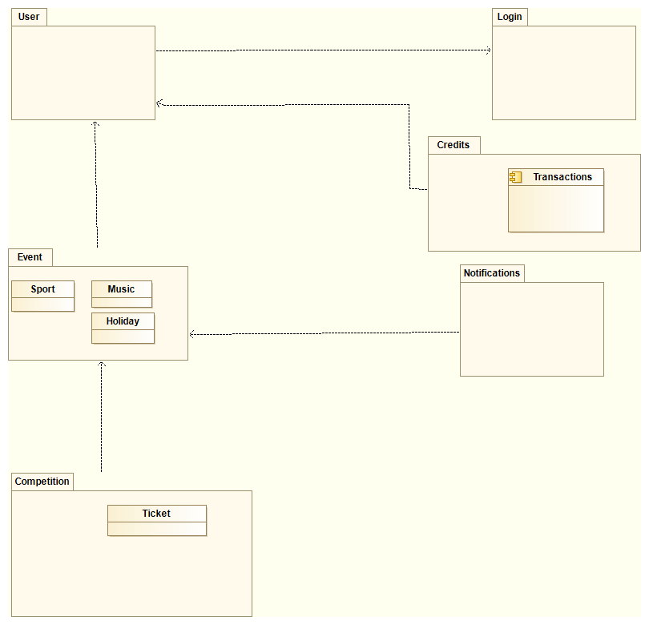
Package Diagram of your Project

Slide 9
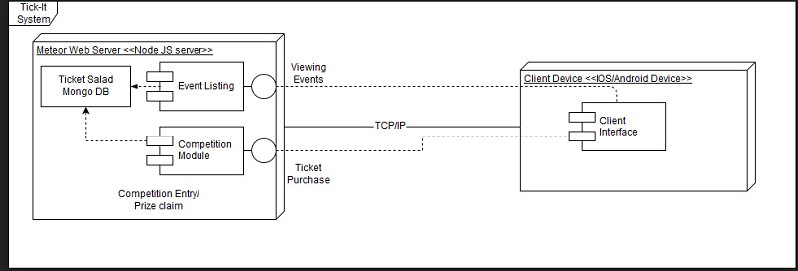
Deployment Diagram

